Slide 1
EECS 490 – Lecture 7 Recursion and Higher-Order Functions

Slide 2
Announcements
Homework 2 due on Friday
Project 2 due Fri 10/6

Slide 3
Review: Call by Result
Argument must be l-value
Parameter is a new variable with its own storage
Parameter is not initialized with argument value
Upon return of the function, parameter value is copied to argument object
Can only be used for output void foo(result int x) { x = 3; ... x++; // x is now 4 } int y = 5; foo(y); // y is now 4

Slide 4
Review: Call by Value-Result
Combination of call by value and call by result
Argument must be l-value
Parameter is a new variable with storage, initialized with argument value
Upon return, value of parameter is copied to argument object int foo(v/r int x, v/r int y) { x++; return x - y; } int z = 3; print(foo(z, z)); // prints 1
Notes:
Differs from call by reference. In call by reference, would print 0, since x and y would alias the same storage. Final value of z depends on whether x or y is copied last to z.

Slide 5
Call by Name
Any expression provided as argument
Parameter name is replaced by argument expression everywhere in the body
Expression computed whenever it is encountered in body void foo(name int x) { print(x); // becomes print(++y) print(x); // becomes print(++y) } int y = 3; foo(++y); // prints 4, then 5; y is now 5

Slide 6
Thunks
In call by name, expression must be computed in its own environment void bar(name int x) { int y = 3; print(x + y); // becomes print(y + 1 + y) } int y = 1; bar(y + 1); // should print 5, not 7
This is accomplished with a thunk, a compiler-generated local function that packages the expression with its environment
Notes:
More on local functions next week.

Slide 7
Python is Call by Value
Call by value is most common mode, followed by call by reference
Python and Java are not call by reference
They combine call by value with reference semantics
This is sometimes called "call by object reference"
def swap(x, y): tmp = x x = y y = tmp >>> x, y = 1, 2 >>> swap(x, y) >>> x, y (1, 2)
x and y are new variables with their own storage

Slide 8
Agenda
Recursion
Function Objects
Functions as Parameters
Nested Functions

Slide 9
Overview of Recursion
A function is recursive if it calls itself directly or indirectly
A recursive computation has
Base cases: cases that can be computed directly without recursion
Recursive cases: a case that can be computed from the solution to a "smaller" case; the smaller case is solved with a recursive call
Recursion can be used for repetition instead of iteration

Slide 10
Activation Records
Recursion works on a machine since every function invocation gets its own activation record def factorial(n): if n == 0: return 1 return n * factorial(n - 1)

Slide 11
Implicit Data in Activation Records
An activation record includes implicit data needed by the function invocation
Storage for temporary values
Address where to place the return value
Address of caller's code and activation record
The set of implicit items can be determined statically def factorial(n): if n == 0: return 1 return n * factorial(n - 1)

Slide 12
Space Usage of Factorial
Computation of factorial(n) requires n + 1 invocations to be active at the same time def factorial(n): if n == 0: return 1 return n * factorial(n - 1)
Compare to iterative version: def factorial_iter(n): result = 1 while n > 0: result *= n n -= 1 return result

Slide 13
Alternate Definition of Factorial
We can define another recursive version that:
Does no computation after the recursive call
Directly returns the result of the recursive call def factorial_tail(n, result = 1): if n == 0: return result return factorial_tail(n - 1, n * result)

Slide 14
Tail-Call Optimization
A call is a tail call if its caller directly returns the result without performing additional computation
Tail-call optimization reuses the space for the caller's activation record for that of the tail call
Some implicit data is also reused for the tail call:
Address where to place return value
Address of caller's code and activation record def factorial_tail(n, result = 1): if n == 0: return result return factorial_tail(n - 1, n * result) def foo(): print(factorial(4))

Slide 15
Tall-Call Optimization Failures
Implicit computation, such as destructors, can prevent optimization int sum(vector<int> values, int index, int partial_result = 0) { if (values.size() == index) { return 0; } return sum(values, index + 1, partial_result + values[index]) }
Nested function definitions can prevent optimization

Slide 16
Function Objects and State
A function object (also called a functor) is an object that isn't a function but provides the same interface
Allowing the function-call operator to be overridden enables function objects to be defined
Function objects can have state that is associated with an instance of the functor
State shared among all invocations of the same instance
Different than top-level functions, which only have state that is associated with a single invocation or with all invocations of the function

Slide 17
Function Objects in C++
Functors can be written by defining a class that overrides the operator() member function class Counter { public: Counter : count(0) {} int operator()() { return count++; } private: int count; };
Can have parameters, just like functions
Counter counter1, counter2;
cout << counter1() << endl; // prints 0 cout << counter1() << endl; // prints 1
cout << counter1() << endl; // prints 2
cout << counter2() << endl; // prints 0
cout << counter2() << endl; // prints 1
cout << counter1() << endl; // prints 3

Slide 18
Function Objects in Python
Functors override the __call__ special method class Counter: def __init__(self): self.count = 0 def __call__(self): self.count += 1 return self.count - 1
More parameters can go here
counter1 = Counter()
counter2 = Counter()
print(counter1()) # prints 0 print(counter1()) # prints 1
print(counter1()) # prints 2
print(counter2()) # prints 0
print(counter2()) # prints 1
print(counter1()) # prints 3

Slide 19
"Function Objects" in Java
Java does not have operator overloading
Instead, "function objects" implement an interface with a conventional name for the lone method in the interface class Counter implements Supplier<Integer> { private int count = 0; public Integer get() { return count++; } }
Supplier<Integer> counter1 = new Counter();
Supplier<Integer> counter2 = new Counter();
System.out.println(counter1.get()); // prints 0 System.out.println(counter1.get()); // prints 1 System.out.println(counter1.get()); // prints 2 System.out.println(counter2.get()); // prints 0 System.out.println(counter2.get()); // prints 1 System.out.println(counter1.get()); // prints 3

Slide 20
Break Time!
We’ll start again in five minutes.

Slide 21
Function Pointers
C and C++ allow top-level functions to be passed by pointer void apply(int *A, size_t size, int (*f)(int)) { for (; size > 0; --size, ++A) *A = f(*A); } int add_one(int x) { return x + 1; } int main() { int A[5] = { 1, 2, 3, 4, 5 }; apply(A, 5, add_one); cout << A[0] << ", " << A[1] << ", " << A[2] << ", " << A[3] << ", " << A[4] << endl; }
Automatically converted to function pointer

Slide 22
Environment of Use
A function passed as a parameter has three environments that can be associated with it
The environment where it was defined
The environment where it was referenced
The environment where it was called
Scope policy determines which names are visible in the function
Static/lexical scope: names visible at the definition point
Dynamic scope: names visible at the point of use
In dynamic scope, point of use can be where a function is referenced or where it is called

Slide 23
Binding Policy
Shallow binding: non-local environment is environment from where a function is called
Deep binding: non-local environment is environment from where a function is referenced int foo(int (*bar)()) { int x = 3; return bar(); } int baz() { return x; } int main() { int x = 4; print(foo(baz)); }
Non-local environment in shallow binding
Non-local environment in deep binding

Slide 24
Nested Functions and Closures
The ability to create a function from within another function is a key feature of functional programming
Static scope requires that the newly created function have access to its definition environment
A closure is the combination of a function and its enclosing environment
Variables from the enclosing environment that are used in the function are captured by the closure

Slide 25
Nested Functions and State
A closure encompasses state that can be accessed by the newly created function def make_greater_than(threshold): def greater_than(x): return x > threshold return greater_than
threshold captured from non-local environment
>>> gt3 = make_greater_than(3)
>>> gt30 = make_greater_than(30)
>>> gt3(2)
False
>>> gt3(20)
True
>>> gt30(20), gt30(200)
(False, True)

Slide 26
Modifying Non-Local State
Languages may allow non-local variables to be modified
def make_account(balance): def deposit(amount): nonlocal balance balance += amount return balance def withdraw(amount): nonlocal balance if 0 <= amount <= balance: balance -= amount return amount else: return 0 return deposit, withdraw
>>> deposit, withdraw = \
make_account(100)
>>> withdraw(10)
10
>>> deposit(0)
90
>>> withdraw(20)
20
>>> deposit(0)
70
>>> deposit(10)
80
>>> withdraw(100)
0
>>> deposit(0)
80

Slide 27
Decorators
A common pattern in Python is to transform a function or class by applying a higher-order function to it, called a decorator
Standard syntax for decorating functions: @<decorator> def <name>(<parameters>): <body>
Mostly equivalent to: def <name>(<parameters>): <body> <name> = <decorator>(<name>)

Slide 28
Trace Example
Example: decorator that traces function calls def trace(fn): def tracer(*args): strs = (str(arg) for arg in args) print('{}({})'.format(fn.__name__, ', '.join(strs))) return fn(*args) return tracer @trace def factorial(n): if n == 0: return 1 return n * factorial(n - 1)
>>> factorial(5)
factorial(5)
factorial(4)
factorial(3)
factorial(2)
factorial(1)
factorial(0)
120

Slide 29
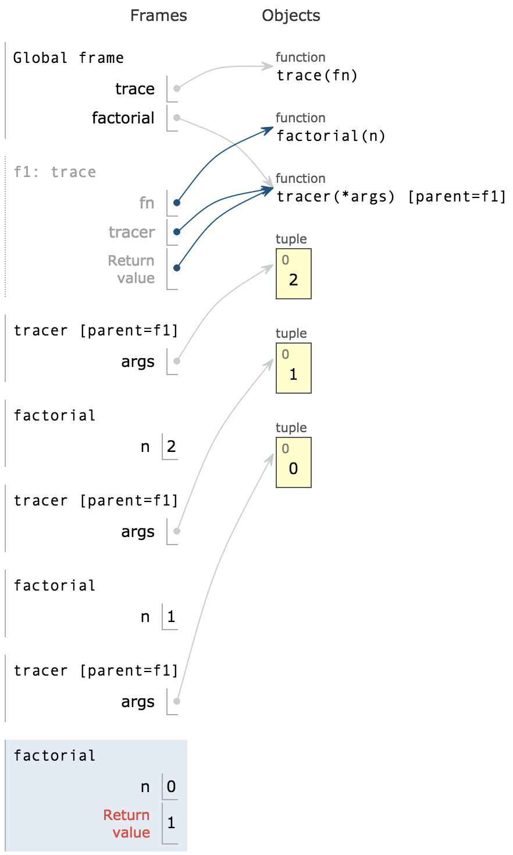
Mutual Recursion
A decorated recursive function results in mutual recursion where multiple functions make recursive calls indirectly through each other
>>> factorial(2)
factorial(2)
factorial(1)
factorial(0)
2

